Slide 1
Section 2
NodeRED
Introduction

Slide 2

Agenda
Workshop Objectives
Give an overview of Watson IoT on IBM Cloud
Agenda
Watson IoT Platform Overview
Lab 1: Getting Started, Connectivity
Node-RED Overview
Lab 2: Data visualization
Watson IoT API overview
MQTT, Device Management, Security
IoT and Analytics
Lab 4: Analysing historical data with a notebook
Cognitive IoT and AI
Lab 5 & 6: ChatBot and Vision

Slide 3
NodeRED Overview

Slide 4
What is Node-RED ?
A visual tool for wiring together services
Not limited to IOT
Node-JS asynchronous runtime engine
Can listen for events on websockets, tcp, twitter etc
Process and manipulate data
Graphically or using java script
Store data
Send data out over websockets, tcp etc

Slide 5
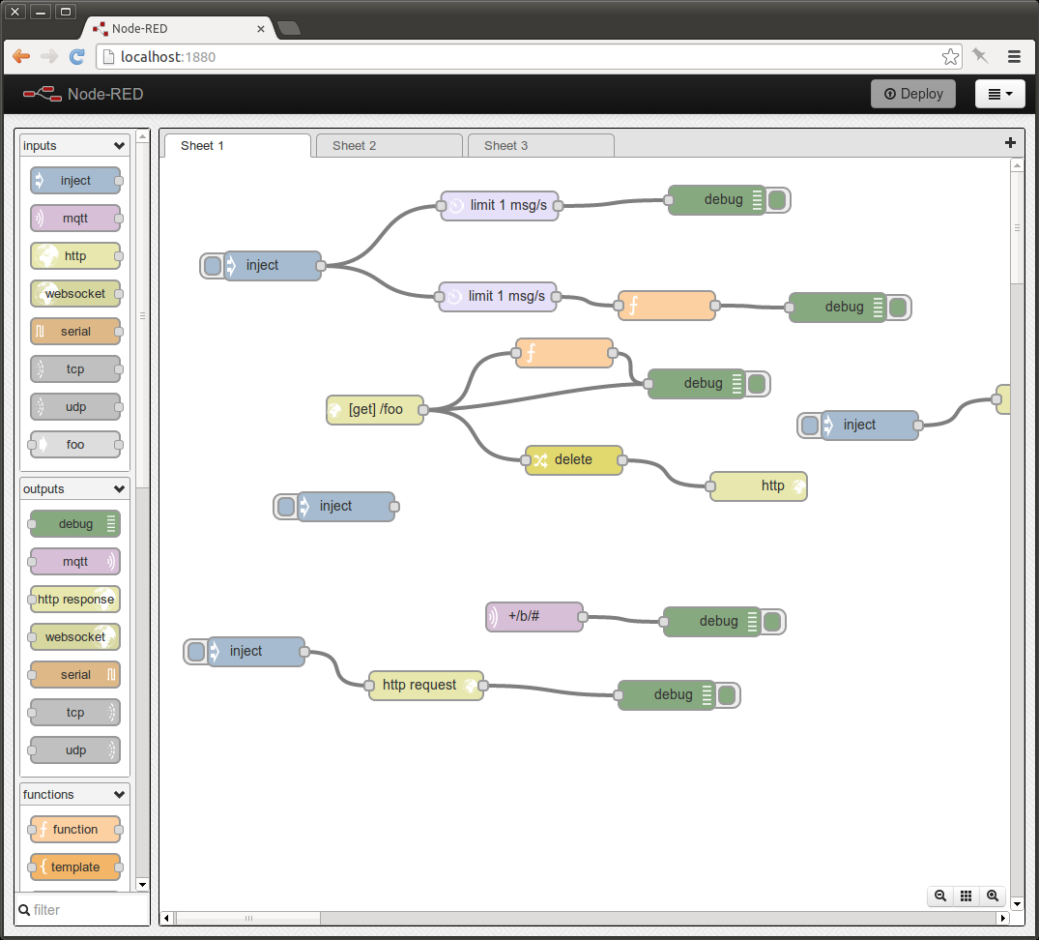
Node-RED makes it easy to wire together the IoT
“A visual tool for wiring the internet of things”
It provides a browser-based UI for creating flows of events and deploying them to the runtime.
Light-weight runtime, built in node.js,
Ideal for edge-of-network environments or running in IBM Cloud
It can be easily expanded by adding new nodes to its palette – taking full advantage of the node package manager (npm) ecosystem

Slide 6
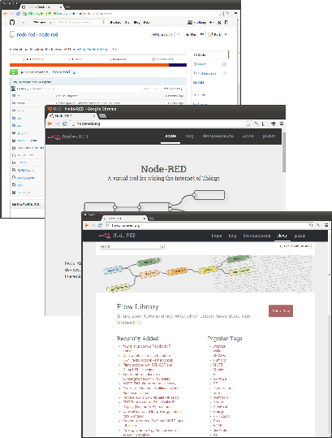
Open Source Development
IBM-originated (Hursley labs, UK)
Released on GitHub September 2013
Apache 2 License
http://nodered.org - main site
Custom nodes ecosystem
http://flows.nodered.org
Over 1400 nodes available
flow library
Encourages sharing and reuse of flows within the community

Slide 7
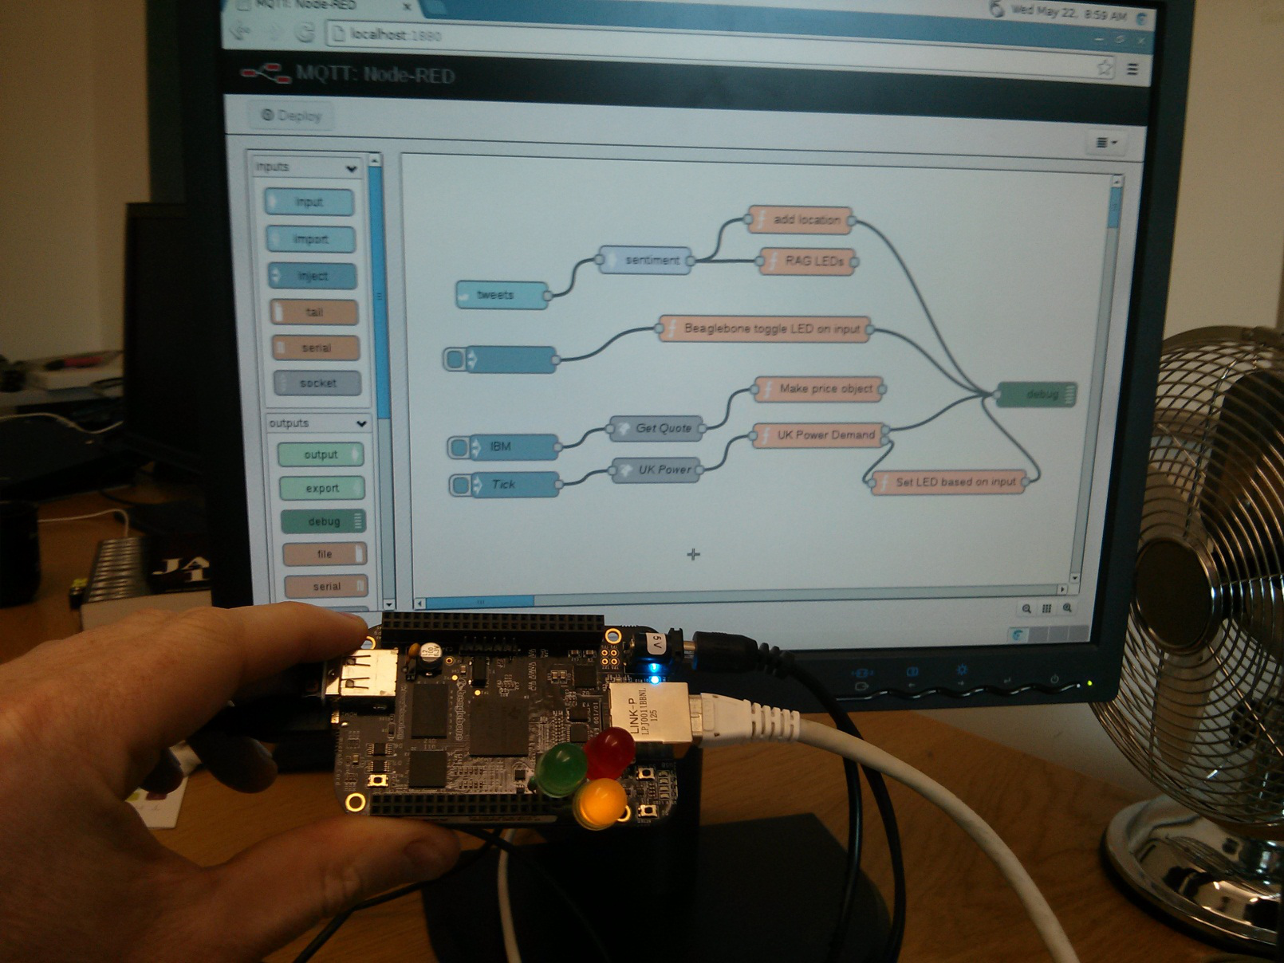
Node-RED running in a device
The board lights LEDs in response to the sentiment of a Twitter stream.

Slide 8

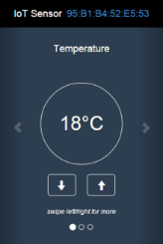


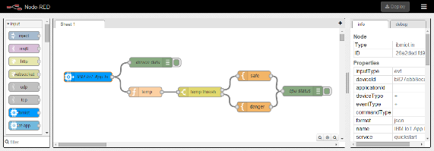
Watson Internet of Things Platform Boilerplate
IBM Cloud Watson IoT Platform Starter Kit Boilerplate for getting going quickly
For use with real devices or simulators
Node-RED editor and runtime customised with WIoTP nodes in its palette
Configuration and Flows are persisted in a Cloudant database

Slide 9
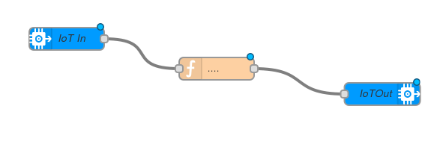
Node-RED Component parts
Browser-based editor. Lets you create flows and deploy them to the runtime
Node-RED editor (UI)
Nodes
Standard node-RED nodes
Third-party contributions
User-written
User-written flow
Flow store
Node-RED runtime
Node.js application.
Executes flows.
Event-driven JavaScript runtime.
Runs in IBM Cloud or standalone (e.g on a device)
node.js runtime

Slide 10
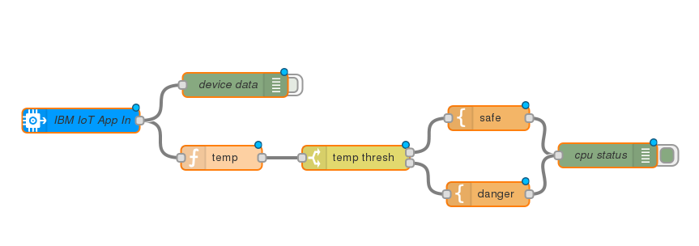
Node-RED Flows and Nodes
These wires are attached to the same terminal, so output from “IoT App in” is copied to both receiving nodes
Input node: reads events from IoTF
Switch node: routes incoming messages to one or more of its output terminals
Debug node: writes output to debug window
Node-RED implements a graphical Data Flow language.
Flows can be imported or exported as JSON objects

Slide 11
JSON version of the flow on the previous slide
[{"id":"3dee4a0b.a71e36","type":"ibmiot in","inputType":"evt","deviceType":"+","format":"json","name":"IBM IoT App In","service":"quickstart","x":157,"y":269,"z":"47cda051.8d4c18", "wires":[["90dd0f60.b08ee8","e344143.da0b3e8"]]},
{"id":"90dd0f60.b08ee8","type":"function","name":"temp","func":"return {payload:msg.payload.d.temp};", "outputs":1,"x":330.5,"y":315,"z":"47cda051.8d4c18","wires":[["5f9326f8.cc5528"]]},
{"id":"5f9326f8.cc5528","type":"switch","name":"temp thresh","property":"payload", "rules":[{"t":"lte","v":40,"v2":0},{"t":"gt","v":40,"v2":0}],"checkall":"true","outputs":2,"x":496.5,"y":315,"z":"47cda051.8d4c18",
"wires":[["8470617.2a0cba"],["39314ca6.c71afc"]]},{"id":"2fab48da.b0a998","type":"debug","name":"cpu status","active":true,"complete":"false","x":807.5,"y":312,"z":"47cda051.8d4c18", "wires":[]},
{"id":"e344143.da0b3e8","type":"debug","name":"device data","active":false,"complete":"false","x":347.5,"y":225,"z":"47cda051.8d4c18","wires":[]},
{"id":"8470617.2a0cba","type":"template","name":"safe","template":"Temperature ({{payload}}) within safe limits","x":660.5,"y":266,"z":"47cda051.8d4c18","wires":[["2fab48da.b0a998"]]},
{"id":"39314ca6.c71afc","type":"template","name":"danger","template":"Temperature ({{payload}}) critical","x":659.5,"y":360,"z":"47cda051.8d4c18","wires":[["2fab48da.b0a998"]]}]
Used to store or exchange flow definitions. Not intended to be read or written by humans.

Slide 12
Nodes on Node-RED
Node-RED has essentially three types of node:
Input nodes
Output nodes
Processing nodes

Slide 13
Input nodes
Allows data to be injected into the flow:
Manually
From an external source
Input nodes have only output pins

Slide 14
Output nodes
Allow sending of data outside the flow:
To external sources for example email, web sockets
To the debug pane
Output nodes have only input pins

Slide 15
Processing nodes
Allow processing of data:
Transform the data
Trigger messages
Write custom code
Watson APIs
Processing nodes have at least one input pin and at least one output pin

Slide 16
Flows in Node-RED
Flows consist of multiple nodes wired together
Nodes produce and consume messages
Messages flow between the nodes

Slide 17
Wiring nodes together
Click and drag (using the left mouse button) from one pin to another to connect nodes
To delete a node or wire - select them with the left mouse button and press the delete key on the keyboard

Slide 18
Messages in Node-RED
Messages are java script objects which have (by default) three attributes:
payload
topic
_msgid
Additional attributes may be added in the flow
Data input to the flow automatically goes into the payload attribute

Slide 19
Inject nodes
Inject nodes may be used to manually inject a payload to test the flow
Clicking the activation button will inject the payload

Slide 20
Debug nodes
Debug nodes may be toggled on or off using their activation button
Only active debug nodes output data to the debug pane
Debug nodes may be configured to display specific attributes from the message - or the entire message
Entire msg object in JSON format
msg.payload

Slide 21
Importing and exporting flows
Flows may be imported or exported:
To JSON formatted text
To a library

Slide 22
What is JSON ?
JavaScript Object Notation
A syntax for storing and exchanging data
An alternative format to XML
Although it uses javascript format it is plain text just like XML
Does not require a DOM to parse
<ships>
<ship>
<name>Serenity</name>
<class>Firefly</class>
</ship>
<ship>
<name>Enterprise</name>
<class>Constitution</class>
</ship>
</ships>
{“ships”: [
{“name”:”Serenity”, “class”:”Firefly”}
{“name”:”Enterprise”, “class”:”Constitution”}
]}
JSON
XML

Slide 23
JSON nodes
JSON nodes take plain text and turn it into a JSON object
The input must be correctly formatted
Equivalent to the standard javascript function
var msg = JSON.parse(text);

Slide 24
Deploying flows
Flows must be deployed before they may be used
Nodes that have changes yet to be deployed are given an icon as a visual reminder
Deploying is extremely fast so a full deploy is usually recommended

Slide 25
Change nodes
Change nodes are very powerful and allow you to manipulate, replace and even delete the message content
In this example the payload is a JSON object - the node takes some of those fields and adds them as attributes to the message itself
It then replaces the message payload with the contents of just one of those fields
The rules are processed in ordered sequence

Slide 26
Switch nodes
Switch nodes allow you to redirect a message depending on some condition
In this example the message is sent to one of four output pins depending on the value of the lang attribute
Note that this is an additional attribute added to the message earlier in the flow

Slide 27
Subflows
Subflows may be created:
Manually
Automatically from a selection
Subflows become new re-usable nodes in the pallette

Slide 28
Subflows example - 1
Created from a selection
Instances of subflows become different tabs

Slide 29
Subflows example - 2
Subflows are nodes in their own right and may be instantiated many times

Slide 30
Data storage & scope
In addition to the msg object which passes between nodes there are other objects which may be used to store and retrieve data:
Context: the context object allows Function nodes (only) to store and retrieve data between invocations
For example to count how many times the function has been executed
Flow: the flow object allows any node in the flow (on a given tab*) to access the data stored within it
Global: available to all nodes across the canvas (on all tabs)
*If you use subflows - globals must be used to shared data between them and other flows

Slide 31
Scope example

Slide 32
Scope in change and switch nodes
In addition to the msg variables, nodes like switch and change may also access the flow and global variables:

Slide 33
Lab2: Visualization
Lab2_SmartLampVisualize.pdf

